Slide 1
AI-Based Threat Intelligence and Prediction System
Anshika Tyagi

Slide 2
CONTENTS
Introduction
Background
Implementation Details
Results and Analysis
Conclusion

Slide 3

1. INTRODUCTION
The spread of cyberthreats in the modern era presents serious difficulties for businesses all around the world. In many cases, sophisticated attacks are difficult to detect and mitigate using conventional cybersecurity techniques. The goal of this project is to create an AI-Based Threat Intelligence and Prediction System that will improve cyber threat detection and prediction by utilizing machine learning techniques. By analyzing phishing site URLs, this system will categorize them as benign or malicious, taking a proactive approach to cybersecurity.

Slide 4

2. Background
The process of obtaining, evaluating, and interpreting data regarding present and future risks to an organization is known as threat intelligence. It seeks to offer practical insights to improve security posture. Conventional approaches frequently depend on manual procedures and static rules, which are inadequate to counter threats that are dynamic and ever-changing.
Advanced threat intelligence capabilities are provided by machine learning (ML) and artificial intelligence (AI). Artificial intelligence (AI)-based systems can improve threat detection speed and accuracy by analyzing large datasets, finding patterns, and making predictions. The goal of this project is to categorize phishing URLs—which are frequently used in cyberattacks to trick users into divulging sensitive information—using artificial intelligence techniques.

Slide 5
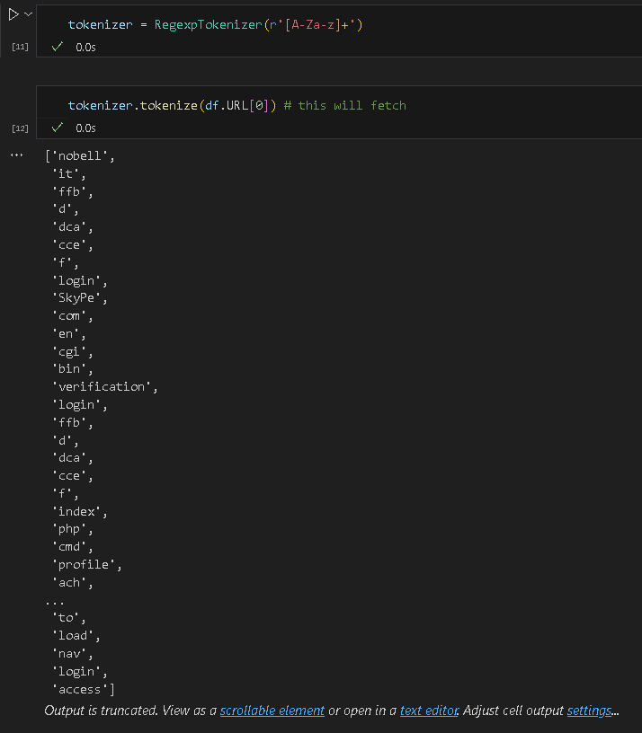
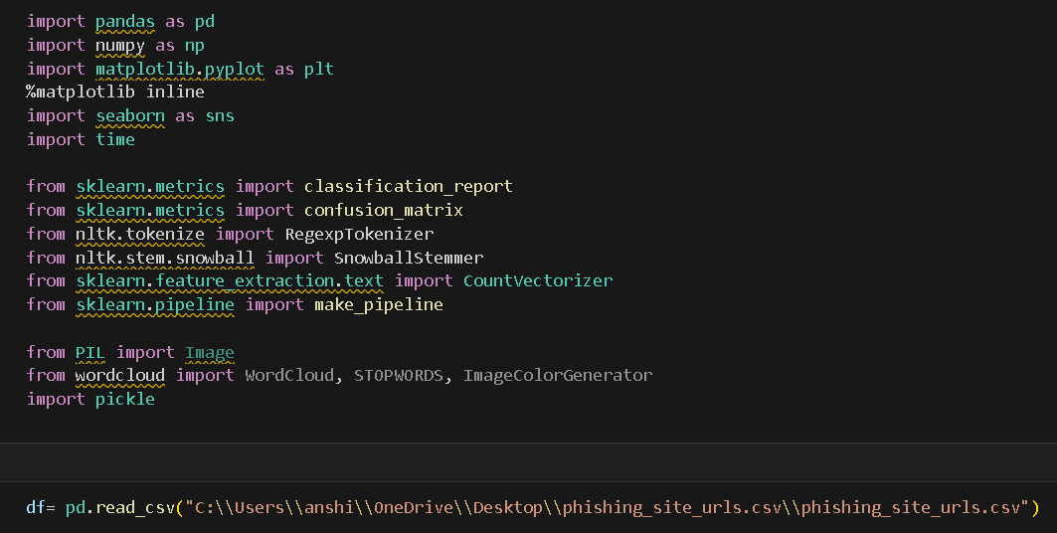
3. Implementation Details
3.1 Data Collection and Preprocessing: The dataset used in this project consists of phishing site URLs, sourced from Kaggle. The implementation involves several key steps:
Data Loading: The dataset is loaded using Pandas.
Exploratory Data Analysis (EDA): Understanding the dataset through basic statistics and visualizations.
Tokenization: Splitting URLs into individual tokens.
Stemming: Reducing words to their base or root form.
Joining Tokens: Reconstructing URLs from tokens for further processing.
3.2 Data PreprocessingTokenization:
Using RegexpTokenizer to split URLs into tokens.
Stemming: Using SnowballStemmer to reduce tokens to their root forms.Joining
Tokens: Combining tokens back into strings.

Slide 6
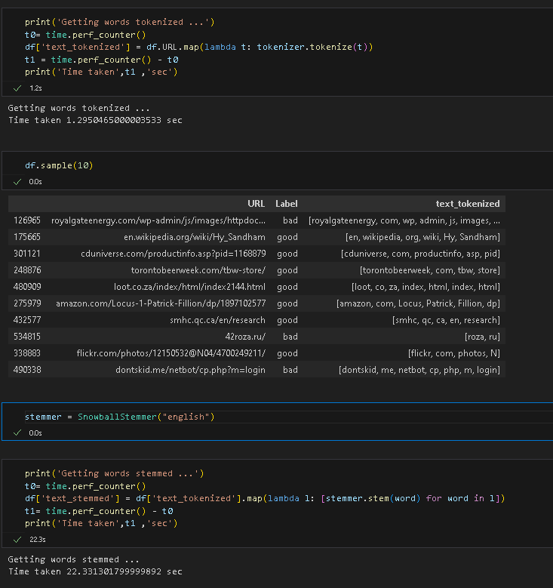
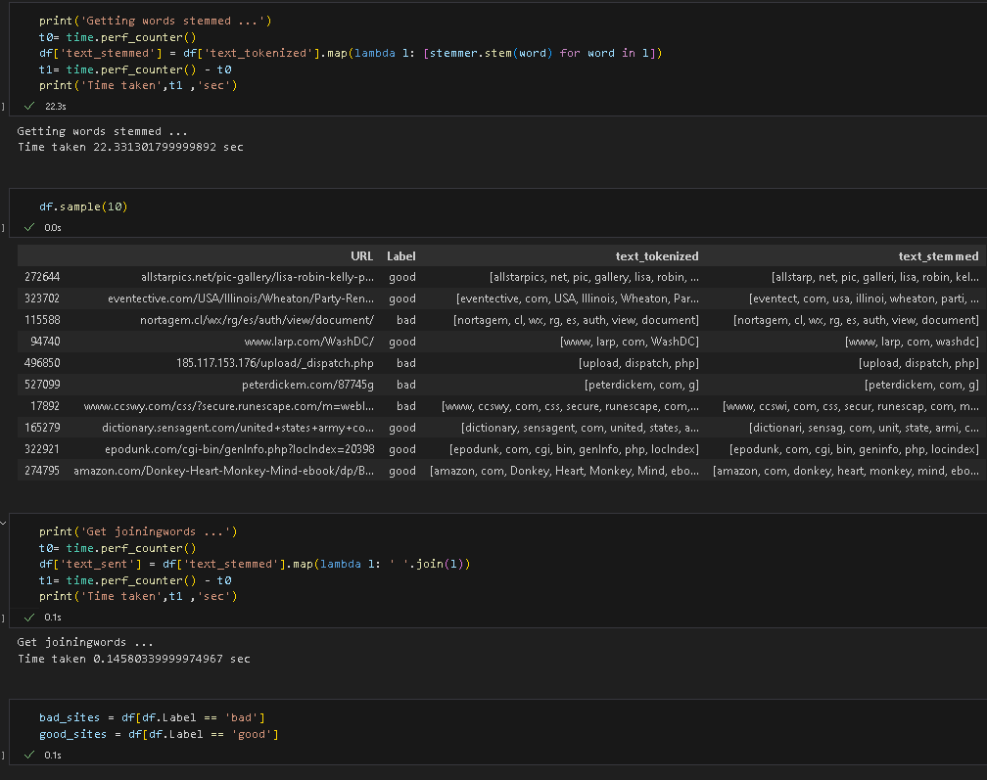
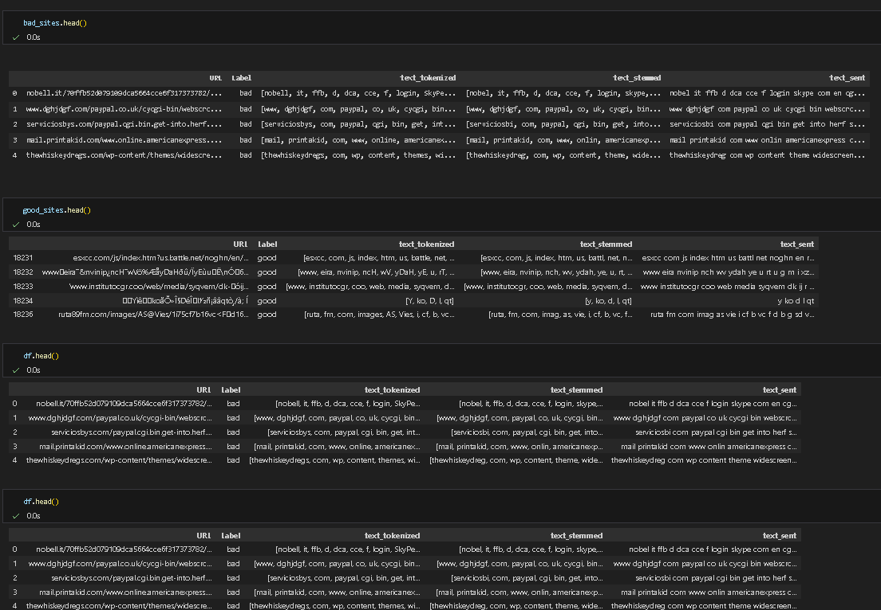

Slide 7
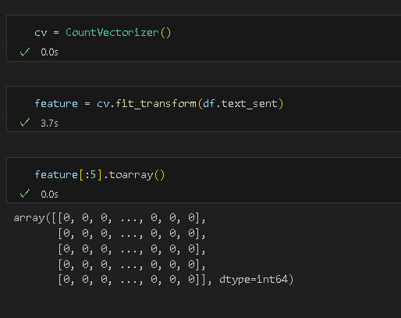
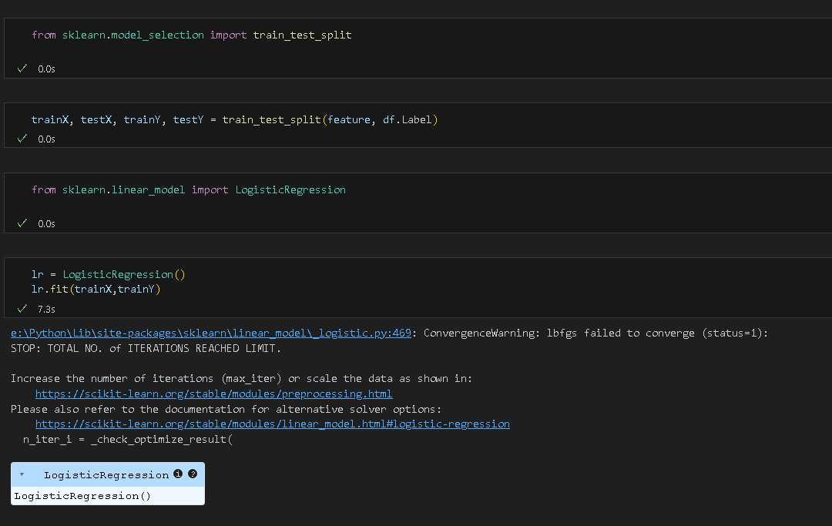
3.3 Feature Extraction Count Vectorizer : Converting text data into numerical features using Count Vectorizer.c
3.4 Model Training and Evaluation:
Logistic Regression: Training and evaluating a logistic regression model.
Multinomial Naive Bayes: Training and evaluating a multinomial Naive Bayes model.

Slide 8
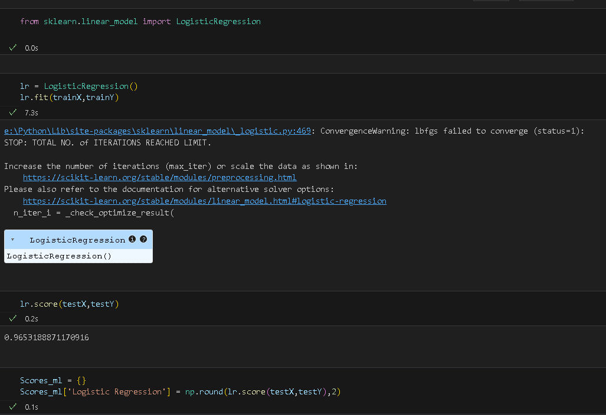
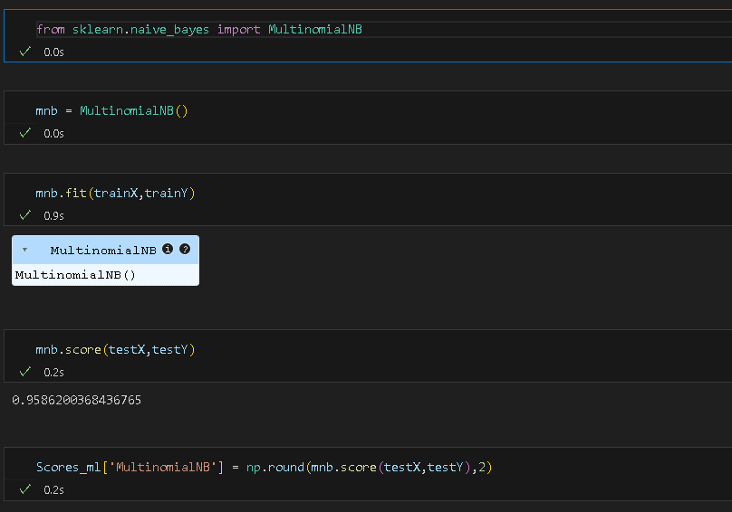
3.5 Model Comparison
Accuracy Comparison: Comparing the accuracy of different models using a bar plot.

Slide 9
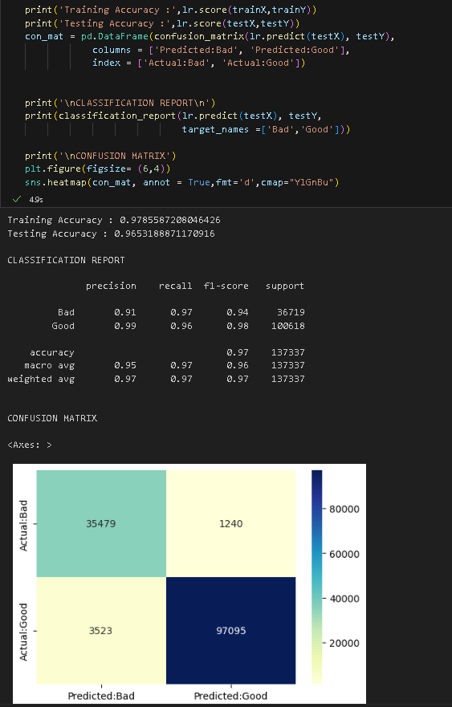
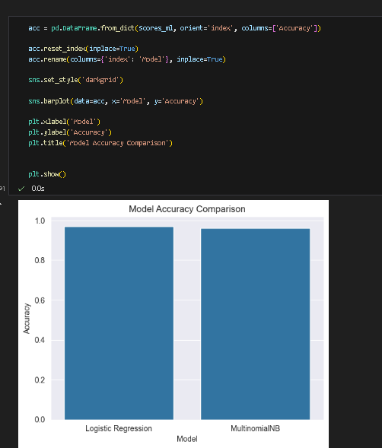
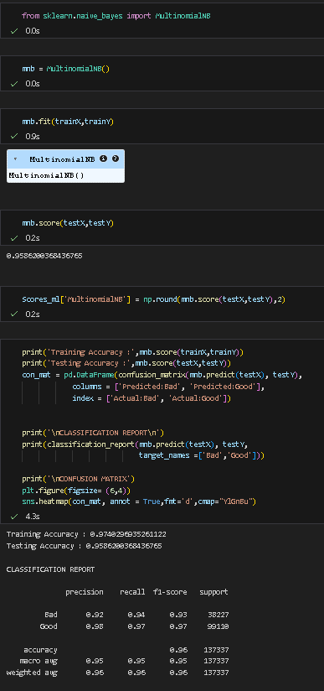
4. Results and Analysis
4.1 Logistic Regression
Training Accuracy: 98%
Testing Accuracy: 97%
4.2 Multinomial Naive Bayes
Training Accuracy: 96%
Testing Accuracy: 95%

Slide 10
5. Conclusion
The AI-Based Threat Intelligence and Prediction System demonstrated effective performance in classifying phishing URLs using machine learning techniques. Both Logistic Regression and Multinomial Naive Bayes models showed high accuracy, with Logistic Regression slightly outperforming in this context. The system can be further enhanced by incorporating additional features and advanced algorithms to improve prediction accuracy and robustness.

Slide 11

References
Books:
"Artificial Intelligence in Cybersecurity" by Leslie F. Sikos.
"Machine Learning and Security" by Clarence Chio and David Freeman.
Articles:
"The Role of Artificial Intelligence in Cyber Security" by John A. Clark.
"Predictive Threat Intelligence Using Machine Learning" by Karen Scarfone.
Websites:
Darktrace
QRadar

